Slide 1
SORRENTO LIGA CONGRESS 2019
DEGROOTE FILIP, M.D. - Bruges (Belgium)

Slide 2
INTRODUCING myself
Practicing classical homeopathy since more than 40 years.
Publications:
Dream Repertory (Radar Opus), containing about 160 000 additions (which means the same volume of the existing Mind and Dream sections together in the Synthesis Repertory).
So doubling up the volume of the Mind symptoms !!!
Energetic Examination, based on applied kinesiology to verify the found homeopathic remedy.
(first electronical version in Radar Opus in 1996, upgraded in 2014)
A lot of other publications (Radar Opus; Links; ..) : see on my website: www.filipdegroote.be
Last article: How to save and preserve classical homeopathy in the future - Ten simple rules to find the appropriate homeopathic remedy (18 Oct. 2019 - hpathy.com)

Slide 3
Keys to prescribe a remedy
Peculiar and unusual symptoms (Organon § 153)
2. (Bizar or exaggerated) Mental Symptoms (!!! not taking in account the cultural customs and family education / tradition)
NOTE : The mind consists of :
The rational, emotional, and instinctual mind
The subconscious – DREAMS
3. NEW symptoms (since the last remedy)

Slide 4
IMPORTANCE OF A COMPLETE REPERTORY
WHICH MUST CONTAIN:
New remedies
Additions from practice
Resonant symptoms (signature of the source)
DREAMS (!!! Dream Repertory – Degroote)

Slide 5
CHALLENGES FOR HOMEOPATHS OF THE NEW GENERATION (In the Berberis article of) Santos Uta / König Peter (Links -1994, vol. 7)
As a result of our work, we therefore extend the request for a review and new description of many headings (especially concerning dreams).
We are certain that with the high rating of dreams in homoeopathy, as it becomes more and more "modern", the homoeopathic education must receive new impulses. We, the homoeopathic doctors, are called upon to develop our dream culture.

Slide 6
CASE – Example 1
Follow-up of a man of 75-years old.
Former / last remedy: Iris MK – 4,5 months ago.
Now he complains since some weeks of pain at both upper trapezii when turning the head and looking upward.
He dreamed of going to a restaurant with the family and however he made a reservation, it was not registrated. After waiting a very long time they get a place on the outside terrace and are served an abondant fish meal. They could not eat it all and when they wanted to pay the restaurant was already closed and no one of the personnel was still there. So they had to leave without paying.

Slide 7
SymptomS / THEME
Symptoms:
Back, Pain, Cervical, looking upward; turning head agg.
Dream: (Dream Repertory - dgt):
Dream, Restaurant, pay, they do not have to - because the owner closes the restaurant before they had finished the meal = graph.

Slide 11
The energetic examination
The energetic examination is an examination based on applied and clinical kinesiology. The idea behind is that homeopathy and acupuncture are both energetic medicines.
Only acupuncture has an energetic model (acupuncture points and muscles which receive energy each by an individual meridian) and this can be used to control (verify) each individual homoeopathic remedy.
Each remedy has its own energetic picture, as if a signature (and 'must' be found in order to prescribe).

Slide 12
HOMEOPATHY related to acupuncture
ENERGY
VITAL FORCE CHI
(undefined) Meridians Acu-points
(homeopathic symptoms) Muscle tonus
(homeosiniatry) Acu-points

Slide 13
Case – EXAMPLE 2
Follow-up of a 65-years old woman.
Former / last remedy: Mag-s. - 5 months ago.
Now she complains about want of general energy. New since last time was a strange feeling on the right side of the head, as if it was numb with also the sensation as if the head at that side was filled with cotton wool.
She dreamed that she’s descending stairs from the dike to reach the beach.

Slide 14
Symptom / THEME
Theme of the dream: being attracted to the sea (= this is in this case a resonant symptom)
Dream repertory: Dream, beach / waterline (60 remedies)
Symptom: (Radar Opus) = Key-note symptom
Head, Full, cotton, as by : one remedy = hippo-k. (hippocampus kuda)

Slide 18
Case – EXAMPLE 3
Follow-up of a 67-years old woman, having an erythematous eczema at the external throat.
Former / last complaint/remedy: Vertigo/ Rhus glabra - some weeks ago.
She dreamed that she’s at her former work and that a colleague is making a scornful remark to a superior who just told them he recently published a book.
She dreamed that she was on the toilet to urinate and she could not stop the flow.

Slide 19
SymptoMS (Dream Repertory)
Dream, Scornful remark, (somebody is) receiving a
Dream, Urinating, copious, does not stop
LOCATION: External throat

Slide 20
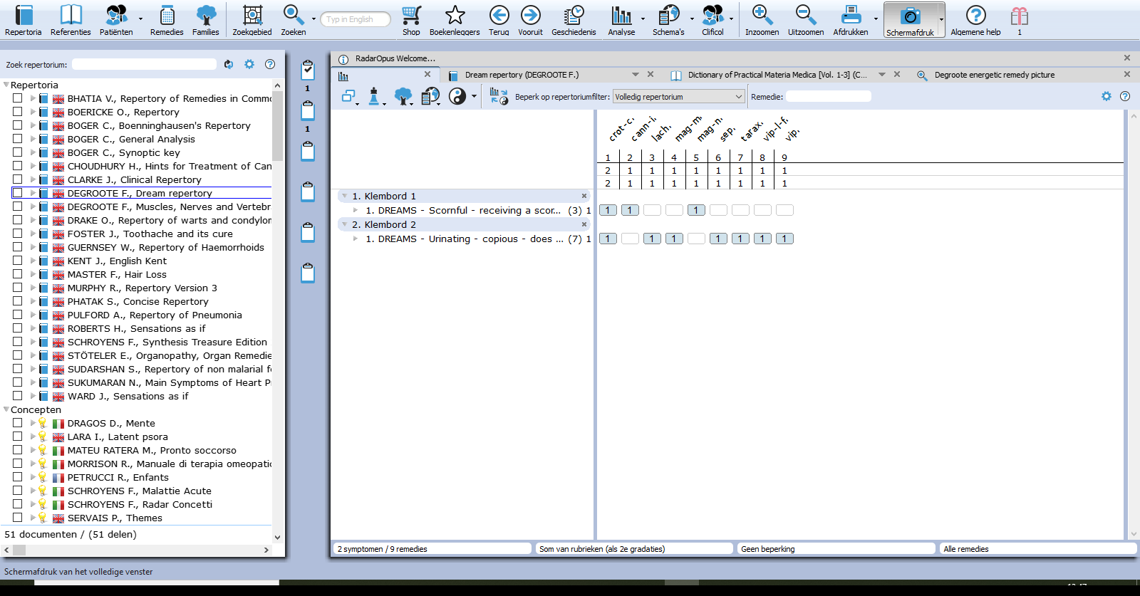

Slide 21
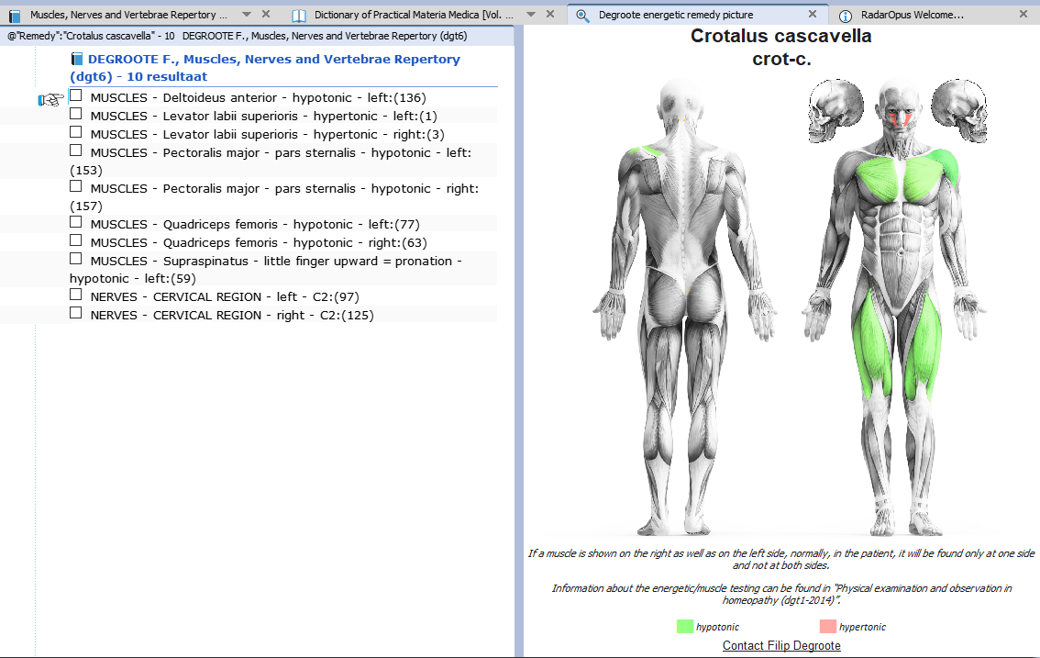

Slide 22
THANK YOU FOR YOUR ATTENTION !!
my website: www.filipdegroote.be
EXPECTED Publication (18 Oct. 2019 in hpathy.com): How to save and preserve classical homeopathy in the future - Ten simple rules to find the appropriate homeopathic remedy

